Slide 1
Presentation brief for MCT’s
Title of presentation | Building Globally Distributed Databases with Cosmos DB.
Presentation\Lab length | Presentation: 40 - 45 minutes. Lab: 40 - 45 minutes.
Audience | Data Professionals, Data Architects, Business Intelligence Professionals, Developers.
Purpose | To understand the capabilities of Cosmos DB and how it can help provide global scale of data. How to insert and query data and see an example of an application that interacts with Cosmos DB.
(think) Student key takeaways | The student should understand that Cosmos DB supports multiple programming models. The student should be clear that Cosmos DB provides a high performing database at global scale.
(feel) Student desired mindset | The student should feel that they are able to clearly describe Cosmos DB to colleagues at work. The student should feel that they show people where Cosmos DB can scale globally.
(do) Student outcomes | The student should be able to provision Cosmos DB. The student should be able to work with the SQL API and understand the concepts of other programming models. The students should be able to enable read and write replicas of a Cosmos DB database.
More information | For MCT course feedback, visit the Microsoft Official Courseware forum

Slide 2

DP-200T01: Building Globally Distributed Databases with Cosmos DB

Slide 3
Agenda
L01 – Create an Azure Cosmos DB database built to scale
L02 - Insert and query data in your Azure Cosmos DB database
L03 - Build a .NET Core app for Azure Cosmos DB in Visual Studio Code
L04 - Distribute your data globally with Azure Cosmos DB

Slide 4










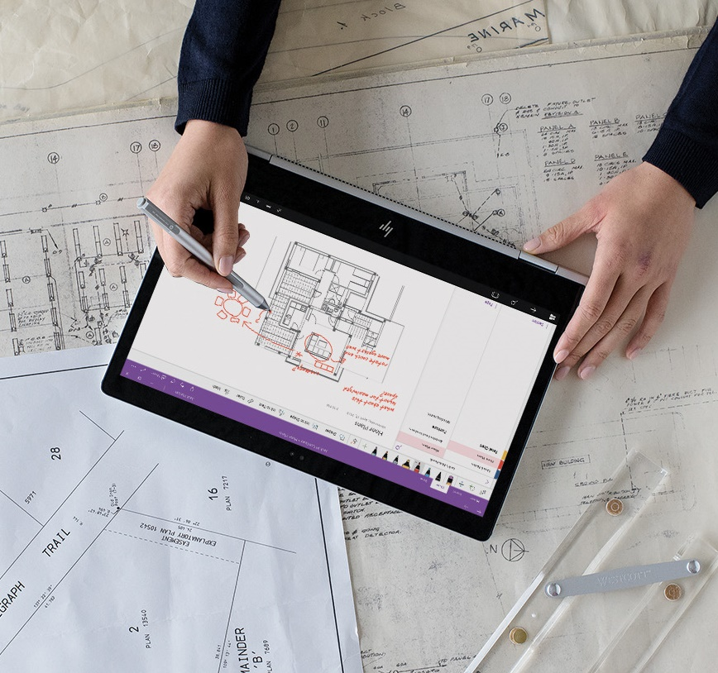


Lesson 01
Create an Azure Cosmos DB
database built to scale
Data
Cloud
AI

Slide 5
Lesson Objectives
What is Cosmos DB
Create an Azure Cosmos DB account
What is a request units
Choose a partition key
Create a database and collection for NoSQL data in Azure Cosmos DB

Slide 6


What is Azure Cosmos DB
Scalability
Performance
Availability
Programming Models

Slide 7
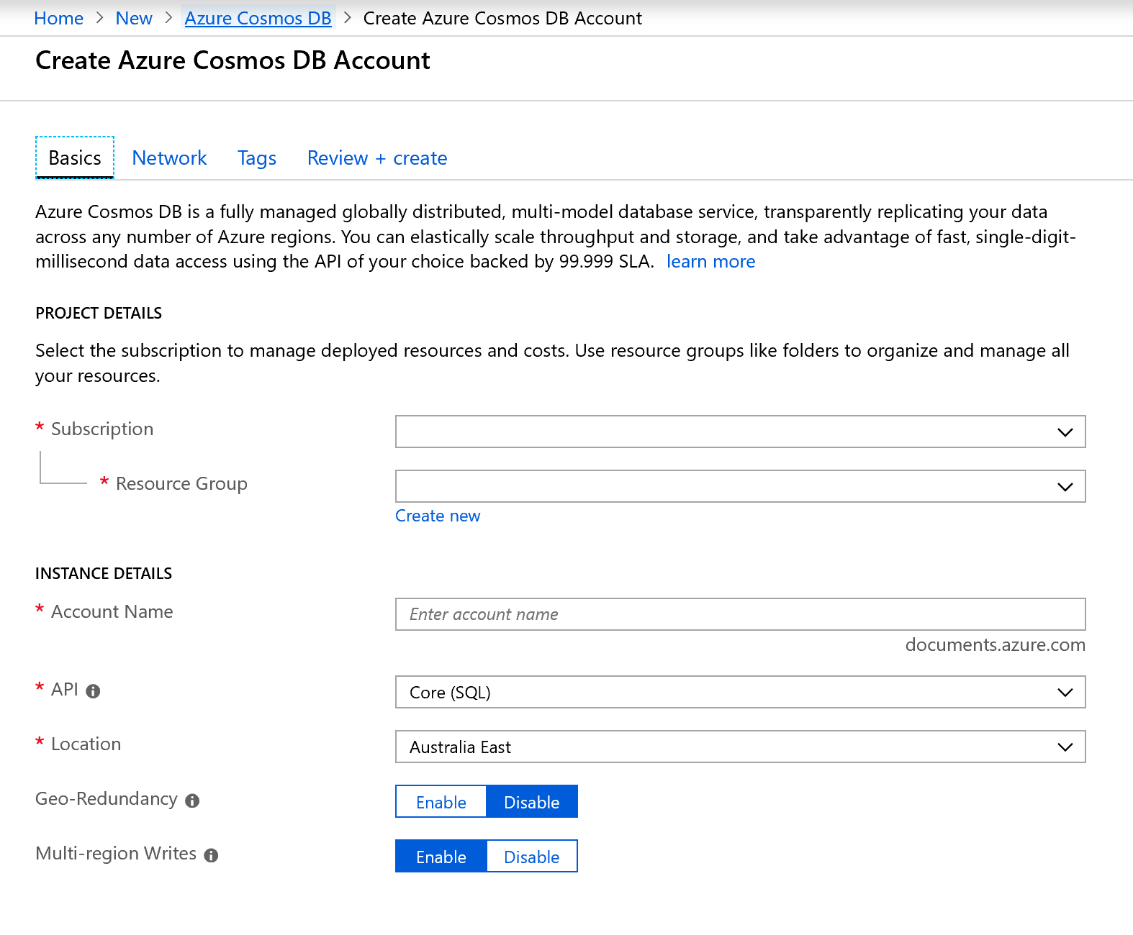
Create an Azure
Cosmos DB Account.

Slide 8
What are Request Units
Throughput is important to ensure you can handle the volume of transactions you need.
Database Throughput
Database throughput is the number of reads and writes that your database can perform in a single second
What is a Request Unit
Azure Cosmos DB measures throughput using something called a request unit (RU). Request unit usage is measured per second, so the unit of measure is request units per second (RU/s). You must reserve the number of RU/s you want Azure Cosmos DB to provision in advance.
Exceeding throughput limits
If you don’t reserve enough request units, and you attempt to read or write more data than your provisioned throughput allows, your request will be rate-limited.

Slide 9
Choosing a Partition Key
Why have a Partition Strategy
Having a partition strategy ensures that when your database needs to grow, it can do so easily and continue to perform efficient queries and transactions
.
Best Practice.
Range of Values
The more values your partition key has, the more scalability you have.
Review Queries
To determine the best partition key for a read-heavy workload, review the top three to five queries you plan on using.
Transactional Workloads
For write-heavy workloads, you'll need to understand the transactional needs of your workload
What is a Partition Key.
A partition key is the value by which Azure organizes your data into logical divisions.

Slide 10
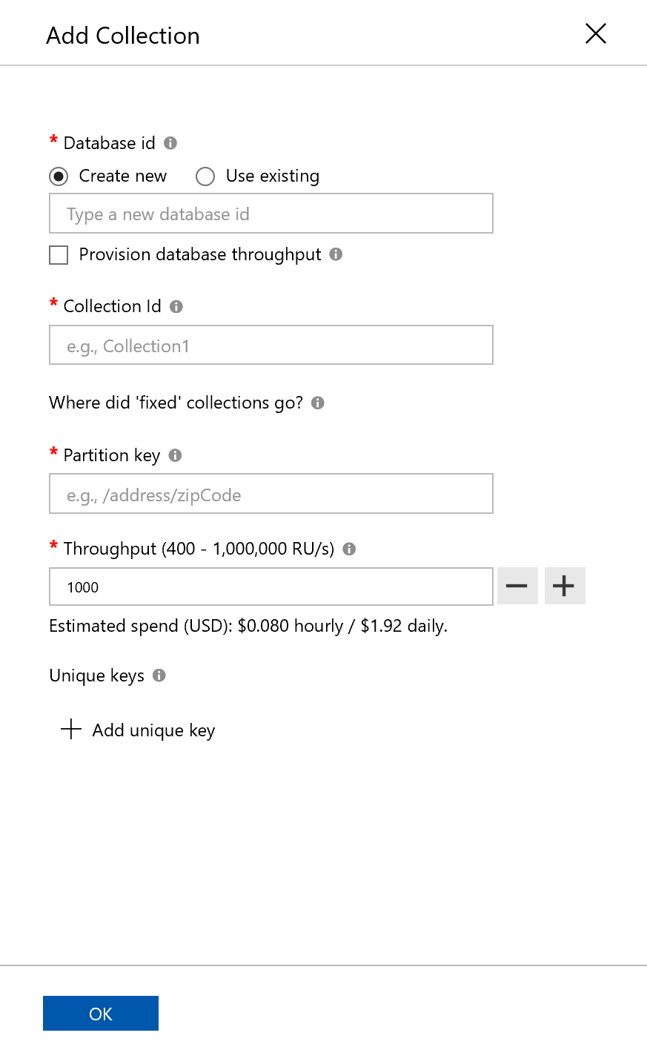
Creating a Database and a Collection in Cosmos DB

Slide 11
Review Questions
Q01 – You want to ensure that there is 99.999% availability for the reading and writing of all your data. How can this be achieved?
A01 – By configuring reads and writes of data for multi-region accounts with multi region writes.
Q02 - What are the three main advantages to using Cosmos DB?
Cosmos DB offers global distribution capabilities out of the box.
Cosmos DB provides a minimum of 99.99% availability.
Cosmos DB response times of read/write operations are typically in the order of 10s of milliseconds.

Slide 12
Lesson 02
Insert and query data in your
Azure Cosmos DB database
Data
Cloud
AI

Slide 13
Lesson Objectives
Create product catalog documents in the Data Explorer
Add data
Perform Azure Cosmos DB queries
Query types
Run queries
Running complex operations on your data
Working with graph data

Slide 14
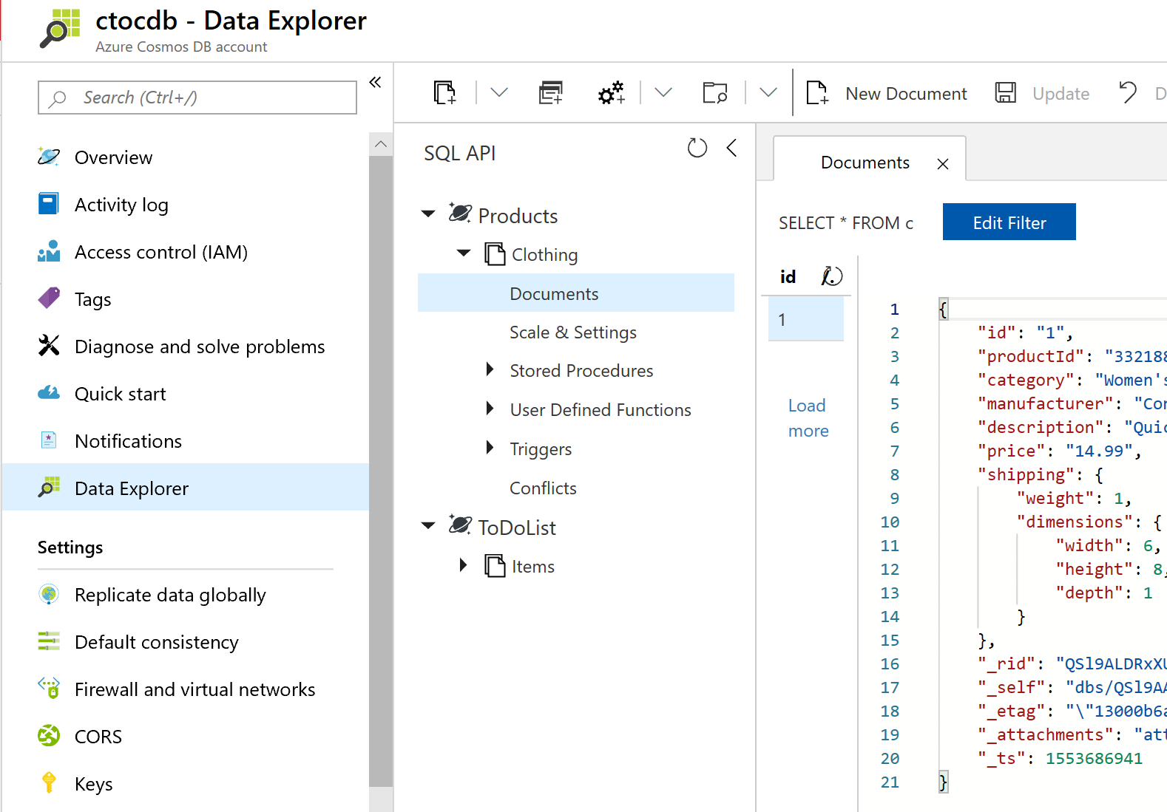
Create a product catalog documents in the Data Explorer.

Slide 15
SELECT Query Basics
SELECT <select_list>
[FROM <optional_from_specification>]
[WHERE <optional_filter_condition>]
[ORDER BY <optional_sort_specification>]
[JOIN <optional_join_specification>]
Perform
Azure Cosmos DB
Queries.
Examples
SELECT *
FROM Products p WHERE p.id ="1“
SELECT p.id, p.manufacturer, p.description
FROM Products p WHERE p.id ="1“
SELECT p.price, p.description, p.productId
FROM Products p ORDER BY p.price ASC
SELECT p.productId
FROM Products p JOIN p.shipping

Slide 16
Running complex operations on data
Multiple documents in your database frequently need to be updated at the same time. The way to perform these transactions in Azure Cosmos DB is by using stored procedures and user-defined functions (UDFs).
Stored Procedures
User Defined Functions
Stored procedures perform complex transactions on documents and properties. Stored procedures are written in JavaScript and are stored in a collection on Azure Cosmos DB.
User Defined Functions are used to extend the Azure Cosmos DB SQL query language grammar and implement custom business logic, such as calculations on properties and documents.

Slide 17
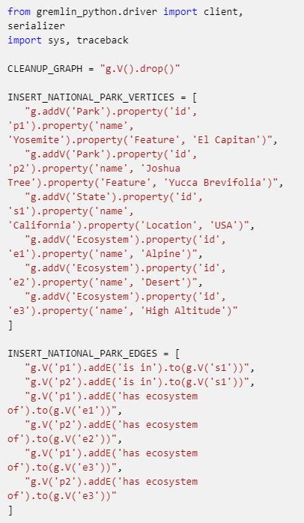
Working with Graph Data

Slide 18
Review Questions
Q01 - You are a data engineer wanting to make the data that is currently stored in a Table Storage account located in the West US region available globally. Which Cosmos DB model should you migrate to?
A01 – Table API
Q02 - What type of data model provides a traversal language that enables connections and traversals across connected data?
A02 – Gremlin API

Slide 19
Lesson 03
Build a .NET Core app for
Azure Cosmos DB in VS Code
Data
Cloud
AI

Slide 20
Lesson Objectives
Create an Azure Cosmos DB account, database, and collection in Visual Studio Code using the Azure Cosmos DB extension
Create an application to store and query data in Azure Cosmos DB
Use the Terminal in Visual Studio Code to quickly create a console application
Add Azure Cosmos DB functionality with the help of the Azure Cosmos DB extension for Visual Studio Code

Slide 21
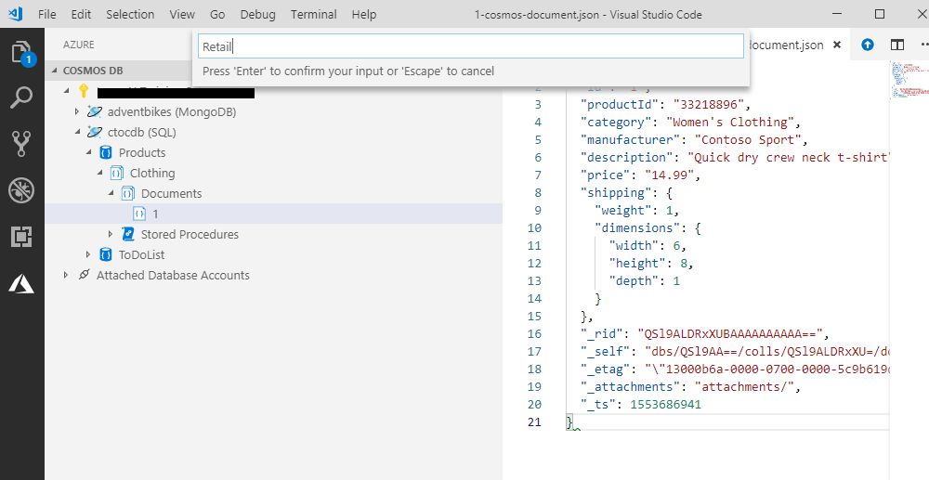
Creating Azure Cosmos DB in Visual Studio Code

Slide 22

Working with documents programmatically
CreateDocument
Async
ReadDocument
Async
ReplaceDocument
Async
UpsertDocument
Async
DeleteDocument
Async

Slide 23
{
// Set some common query options
FeedOptions queryOptions = new FeedOptions { MaxItemCount = -1, EnableCrossPartitionQuery = true };
// Here we find nelapin via their LastName
IQueryable<User> userQuery = this.client.CreateDocumentQuery<User>(
UriFactory.CreateDocumentCollectionUri(databaseName, collectionName), queryOptions)
.Where(u => u.LastName == "Pindakova");
// The query is executed synchronously here, but can also be executed asynchronously via the IDocumentQuery<T> interface
Console.WriteLine("Running LINQ query...");
foreach (User in userQuery)
{
Console.WriteLine("\tRead {0}", user);
}
// Now execute the same query via direct SQL
IQueryable<User> userQueryInSql = this.client.CreateDocumentQuery<User>(
UriFactory.CreateDocumentCollectionUri(databaseName, collectionName),
"SELECT * FROM User WHERE User.lastName = 'Pindakova'", queryOptions );
Console.WriteLine("Running direct SQL query...");
foreach (User in userQueryInSql)
{
Console.WriteLine("\tRead {0}", user);
}
Console.WriteLine("Press any key to continue ...");
Console.ReadKey();
}
Querying document programmatically

Slide 24
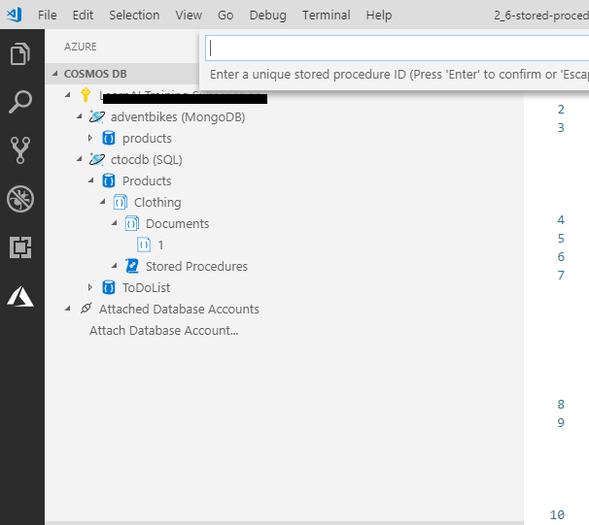
Perform
Azure Cosmos DB
Queries.

Slide 25
Review Questions
Q01 – Suppose you are using Visual Studio Code to develop a .NET Core application that accesses Azure Cosmos DB. You need to include the connection string for your database in your application configuration. What is the most convenient way to get this information into your project?
A01 – Directly from Visual Studio Code
Q02 - When working with Azure Cosmos DB's SQL API, which of these can be used to perform CRUD operations?
A02 – LINQ
Q03 - When working with the Azure Cosmos DB Client SDK's DocumentClient class, you use a NOSQL model. How would you use this class to change the FirstName field of a Person Document from 'Ann' to 'Fran'?
A03 – Call ReplaceDocumentAsync with an updated Person object

Slide 26
Lesson 04
Distribute your data globally
with Azure Cosmos DB
Data
Cloud
AI

Slide 27
Lesson Objectives
Learn about the benefits of writing and replicating data to multiple regions around the world
Cosmos DB multi-master replication
Cosmos DB failover management
Change the consistency setting for your database

Slide 28
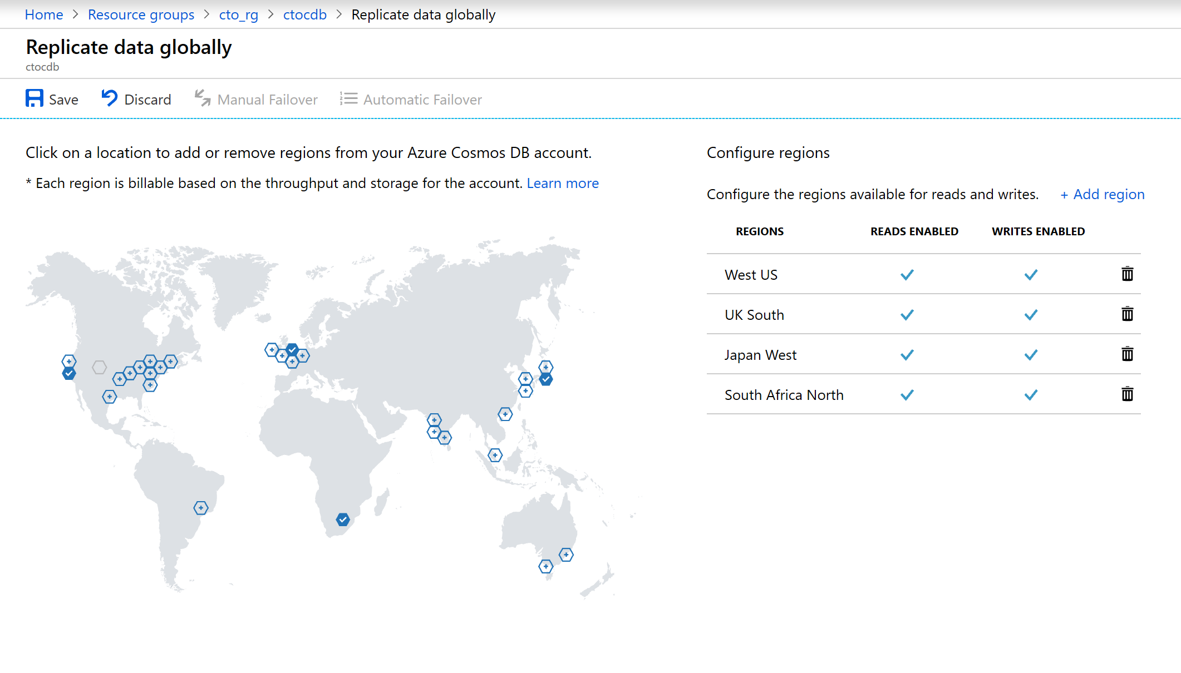
Benefits of writing and replicating data to multiple regions

Slide 29
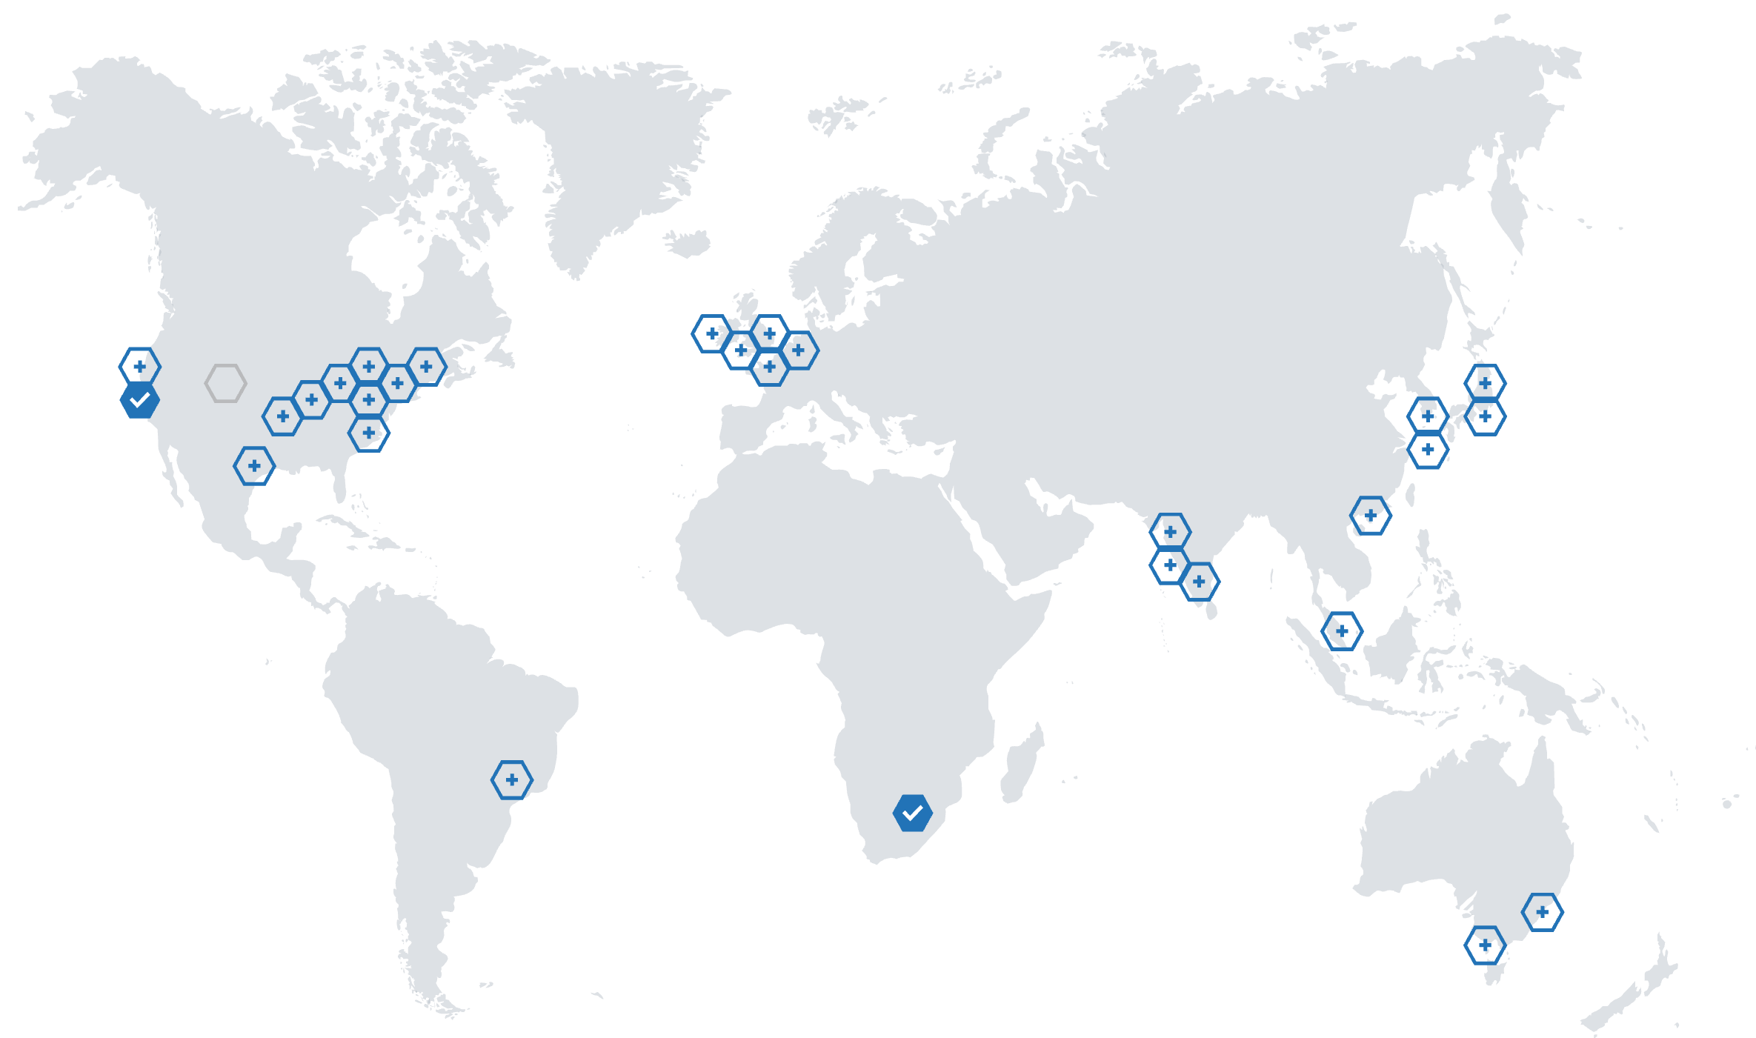
Cosmos DB multi-master replication

Slide 30
Cosmos DB failover management
Automated fail-over is a feature that comes into play when there's a disaster or other event that takes one of your read or write regions offline, and it redirects requests from the offline region to the next most prioritized region.
Read region outage
Write region outage
Azure Cosmos DB accounts with a read region in one of the affected regions are automatically disconnected from their write region and marked offline.
If the affected region is the current write region and automatic fail-over is enabled, then the region is automatically marked as offline. Then, an alternative region is promoted as the write region

Slide 31
Strong
Bounded
Staleness
Cosmos DB
Consistency Levels
Session
Consistent
Prefix
Eventual

Slide 32
Review Questions
Q01 – You want to maximize the data integrity of data that is stored in a Cosmos DB. Which consistency level should you choose?
A01 – Strong

Slide 33

Lab: Lab Title

Slide 34
Lab overview
In this lab, the students will be able to describe and demonstrate the capabilities that Azure Cosmos DB can bring to an organization. They will be able to create a Cosmos DB instance and show how to upload and query data through a portal and through a .Net application. They will then be able to demonstrate how to enable global scale of the Cosmos DB database.
Lab objectives
After completing this lab, you will be able to:
Create an Azure Cosmos DB database built to scale
Insert and query data in your Azure Cosmos DB database
Build a .NET Core app for Azure Cosmos DB in Visual Studio Code
Distribute your data globally with Azure Cosmos DB

Slide 35
Lab scenario
The developers and Information Services department at AdventureWorks are aware that a new service known as Cosmos DB recently released on Azure can provided planetary scale access to data in near real-time. They want to understand the capability that the service can offer and how it can bring value to AdventureWorks, and in what circumstances.
The Information Services department want to understand how the service can be setup and how data can be uploaded. The developers would like to see an example of an application that can be used to upload data to the Cosmos. Both would like to understand how the claim of planetary scale can be met.
At the end of this lad, you will have:
Create an Azure Cosmos DB database built to scale
Insert and query data in your Azure Cosmos DB database
Build a .NET Core app for Azure Cosmos DB in Visual Studio Code
Distribute your data globally with Azure Cosmos DB

Slide 36
Lab review
Exercise 1 – Can you think how Cosmos DB can help your organization?
Exercise 2 – Name the five programming models that is supported by Cosmos DB?
Exercise 3 – What NuGet packages is used to interact with Cosmos DB?
Exercise 4 – How could the distribution of data in Cosmos DB benefit your organization?

Slide 37

Next steps
Module Summary
In this module, you have learned about:
- Create an Azure Cosmos DB database built to scale.
- Insert and query data in your Azure Cosmos DB database.
- Build a .NET Core app for Azure Cosmos DB in Visual Studio Code.
- Distribute your data globally with Azure Cosmos DB.
After the course, consider visiting the Microsoft Cosmos DB Whitepapers site to explore Azure Cosmos DB concepts at a deeper level.

